Slide 1

ngular:
The Awesome Parts
Workshop
John Papa
@john_papa

Slide 2
Get the Content
Slides https://jpapa.me/awesomeng-slides

Slide 3
Scenario Driven Agenda
How do You ...
Plan?
Navigate?
Organize?
Communicate Among Components?
Manage State?
Deploy? (bonus material)
Notes:
Scenario Driven Architecture
Section Planning - 1 hour
Slipstreaming (tools and installs)
Planning arch - questions to ask (what should you ask and have up front?)
Section 2 - Routing - 1 hour
Perceived performance - preload strategies
Save on Leave and Role based views - guards
Section 3 - How Do I Organize My App? - 1 hour
Features and Modules and Libraries
How do create re-usuable shared libraries
Section 4 - Structuring components - 1:15 hour
Container/Presenter vs not
Component communication with RxJS
Assembling ViewModels from your data (map, switch,merge, etc)
Event bus
Section 5 - State management - 1:15 hour
Why do we need state mgt?
Using services
Redux pattern
ngrx-data
Section 6 - Optimize & Deploy - 30 minutes tops
How do I get my app to the cloud?
No docker vs Docker

Slide 4
Demos

Slide 5
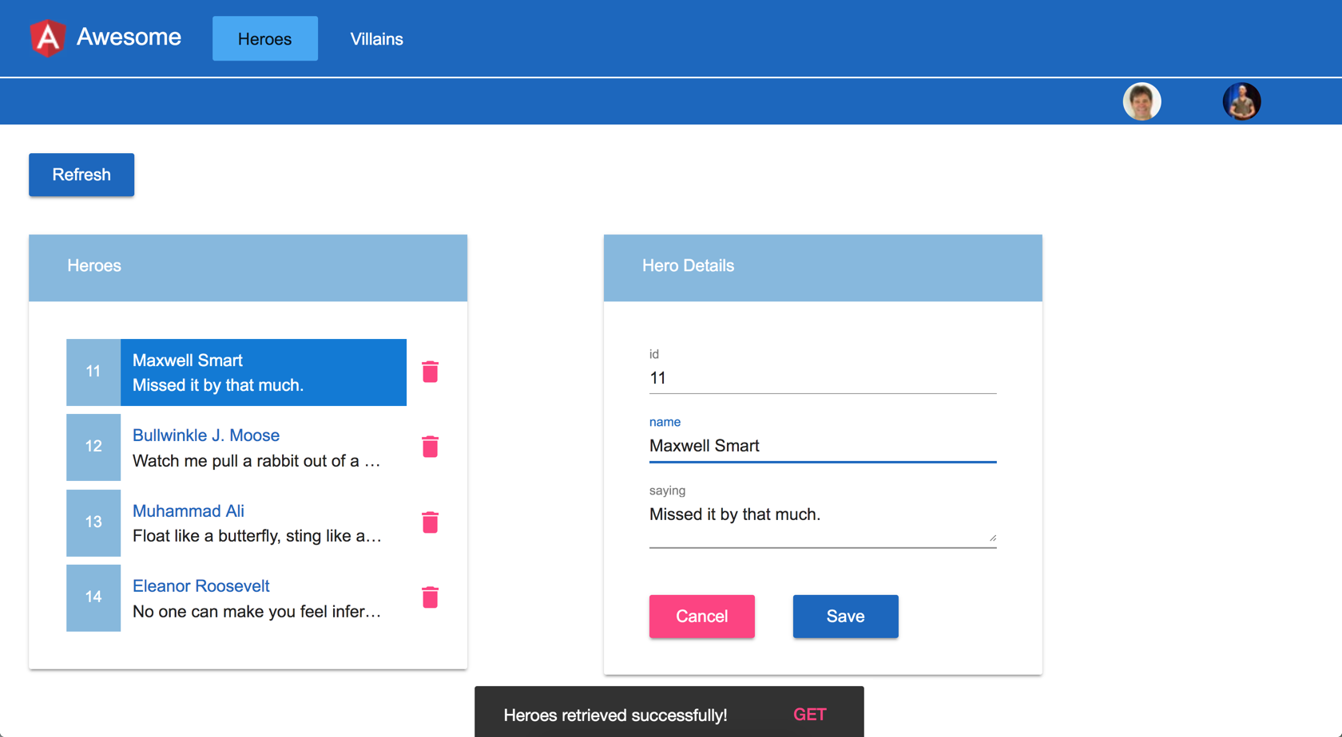
https://github.com/johnpapa/awesome-angular-workshop

Slide 6
OUR LABS
https://github.com/johnpapa/awesome-angular-workshop
https://codewithdan.me/ng-architecture-labs
Click the link above to get the demo we made in the workshop

Slide 7
Getting Started

Slide 8
Slipstream your Angular development
with these tools
Angular CLI
VS Code
Extensions
Chrome Dev Tools

Slide 9
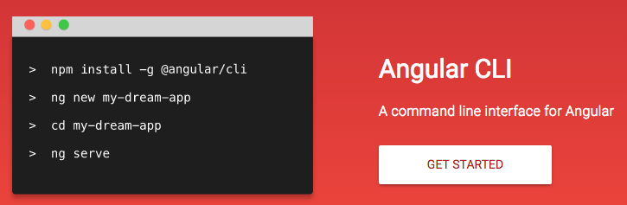
Creating a Project with the Angular CLI
Angular applications can be generated using the Angular Command-Line Interface (CLI): https://angular.io/cli

Slide 10
Installing the Angular CLI
Installed globally with npm
npm install –g @angular/cli

Slide 11
Generating a New Application
ng new my-app
Generate a new app in /my-app
ng new my-app --dry-run
Don’t write the files, but report them
ng new my-app --skip-install
Generate without running npm install

Slide 12
Tip
ng new my-app --routing
--prefix ma
--style scss
--dry-run
Add routing
Set your prefix
Define your styles
Verify the flle names
Remove when ready

Slide 13
Serving Angular
ng serve <options>
ng serve -o
Use the flag --open to open the app in the browser
-o is an alias for --open

Slide 14
Generate code fast and correctly
Efficient dev and debug experience
Solid and powerful build process
Out of the box testing
Easy exit strategy
ROI

Slide 15


http://jpapa.me/ps-ng-cli

Slide 16
Lab Setup
We are using a multi-app Angular CLI project
Each lab has 2 projects: a begin and an end
Run the lab using npm run project-name
> npm run 1-routing-begin
You can also use VS Code to run npm commands

Slide 17
Angular CLI and Multi-App Projects
ng serve 1-begin-routing
Specify the project
to indicate which app to affect

Slide 18
Slides https://jpapa.me/awesomeng-slides
LAB
Install tooling
Get the samples and lab code
Make sure it all works
Also - check this link :)
https://codewithdan.me/ng-architecture-labs
Lab: Tooling and Setup

Slide 19
Slides https://jpapa.me/awesomeng-slides
Install Visual Studio Code from https://code.visualstudio.com/
Install the Angular Essentials extension https://aka.ms/ng-essentials
Install Node.js 8.9 or higher from https://nodejs.org (v10 preferred)
Install the Angular CLI
Install the Chrome extension Redux Dev Tools http://jpapa.me/reduxext
Verify the node and npm installations
Get the source code https://github.com/johnpapa/awesome-angular-workshop
Run npm install
Run the first demo
npm install -g @angular/cli
npm -v
node -v
ng --version
Lab: Tooling and Setup
npm run 0-awesome

Slide 20
Planning Your Architecture

Slide 21
Ask Yourself Some Questions about ...
Features
Security and Rules
Logging
Services / Communication
Data and State
Organizing Your App

Slide 22
How do you
... improve time to first byte?
… save on leave & handle
role based views?
Notes:
Section 2 - Routing
Perceived performance - preload strategies
Save on Leave and Role based views - guards

Slide 23
Navigating
Notes:
Section 2 - Routing
Perceived performance - preload strategies
Save on Leave and Role based views - guards

Slide 24

Angular Routing
Perceived performance
Eager / Lazy Loading
Preload strategies
Routing Guards
Check before leaving
Check before arriving

Slide 25
Eager and Lazy Loading
Routing allows us to load NgModules eagerly or lazily

Slide 26
Loading Routes
Eager
Lazy
At startup
On demand

Slide 27
Defining Lazy Routes
Use loadChildren
Load the module by path and name
Do not import nor reference the module directly
app-routing.module.ts
const routes: Routes = [
{ path: '', pathMatch: 'full', redirectTo: 'customers' },
{
path: 'customers',
loadChildren: 'app/customers/customers.module#CustomersModule' },
{
path: 'orders',
loadChildren: 'app/orders/orders-routing.module#OrdersRoutingModule'
},
{ path: '**', pathMatch: 'full', component: PageNotFoundComponent },
];
Lazy
Eager

Slide 28
A Lazy Loaded NgModule
orders-routing.module.ts
/orders
const routes: Routes = [
{
path: '', component: OrdersComponent,
children: [
{ path: '', component: OrderListComponent },
{ path: ':id', component: OrderComponent}]
},
];
@NgModule({
imports: [RouterModule.forChild(routes)],
exports: [RouterModule],
})
export class OrdersRoutingModule { }
/orders
/orders/37
Must use forChild

Slide 29
Preload Strategies
https://angular.io/guide/router#preloading-background-loading-of-feature-areas
app-routing.module.ts
import { PreloadAllModules, Routes, RouterModule } from '@angular/router';
export const routes: Routes = [ /* routes go here */ ];
@NgModule({
imports: [
RouterModule.forRoot(routes, {
preloadingStrategy: PreloadAllModules
})
],
exports: [RouterModule]
})
export class AppRoutingModule {}
Load all lazily loaded modules ASAP

Slide 30
Route Guards
Guards allow us to make a decision at key points in the routing lifecycle and either continue, abort or take a new direction

Slide 31
Types of Guards
Protect child routes
Protect this route
CanActivate
CanActivateChild
Before we load this code ...
CanLoad
CanDeactivate
Ideal for asking the user if they want to cancel changes before leaving
Ideal for getting data before going to the route destination
Resolve

Slide 32
Creating a CanActivate Guard
Implement the CanActivate interface
Make a determination if the route should be activated
Can re-navigate elsewhere
can-activate-auth.service.ts
@Injectable()
export class CanActivateAuthGuard implements CanActivate, CanActivateChild {
constructor(private userProfileService: UserProfileService, private router: Router) { }
canActivateChild(next: ActivatedRouteSnapshot, state: RouterStateSnapshot) {
return this.canActivate(next, state);
}
canActivate(next: ActivatedRouteSnapshot, state: RouterStateSnapshot) {
if (this.userProfileService.isLoggedIn) {
return true;
}
this.router.navigate(['/login'], { queryParams: { redirectTo: state.url } });
return false;
}
}
Return true or false

Slide 33
Applying Guards
app-routing.module.ts
const routes: Routes = [
{ path: '', pathMatch: 'full', redirectTo: 'customers', },
{ path: 'login', component: LoginComponent },
{
path: 'customers',
component: CustomersComponent,
canActivate: [CanActivateAuthGuard],
canActivateChild: [CanActivateAuthGuard],
children: [
{ path: '', component: CustomersListComponent },
{ path: ':id', component: CustomerComponent },
]
},
{ path: '**', pathMatch: 'full', component: PageNotFoundComponent },
];
Guard the route
Guard the children

Slide 34
Async Guards - Example
can-deactivate.guard.ts
export class CanDeactivateGuard implements CanDeactivate<CanComponentDeactivate> {
canDeactivate(component: CanComponentDeactivate): Observable<boolean> | boolean {
return component.canDeactivate ?
this.toObservable(component.canDeactivate()) : true;
}
private toObservable(deactivate: Promise<boolean> | boolean )
: Observable<boolean> | boolean {
const p = Promise.resolve(deactivate);
const o = Observable.fromPromise(p);
return o;
}

Slide 35
Route Guards
Explore the Event View app
https://github.com/johnpapa/angular-event-view-cli

Slide 36
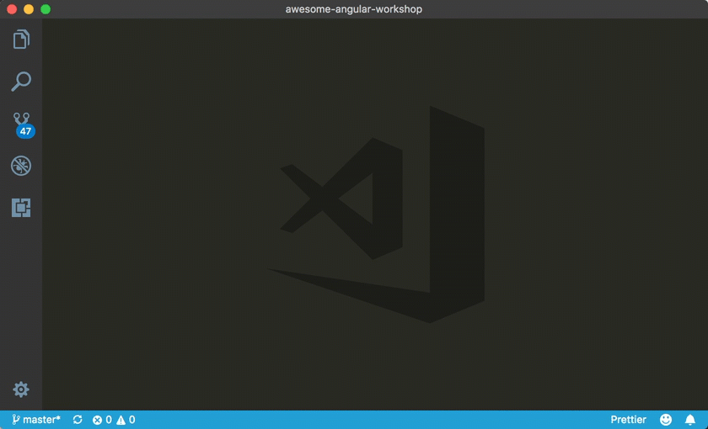
Angular Code Snippets
Tips
https://aka.ms/ng-code
Tips
Use these snippets
a-guard-can-activate
a-guard-can-activate-child
a-guard-can-load

Slide 37
Slides https://jpapa.me/awesomeng-slides
BONUS LAB
Add preload strategy for all lazy routes
Create a CanActivate Guard
Prevent navigating to Villains
Prevent loading of the Villains code chunk
npm run 1-routing-guards-begin
Lab: Routing Guards

Slide 38
Slides https://jpapa.me/awesomeng-slides
Add the PreloadAllModules strategy to the AppRoutingModule
Run the app, open dev tools - network tab
Notice heroes and villains chunks both loaded
Create a CanActivate routing guard in the CoreModule named AuthGuard using the CLI (hint: create a service)
Use a-guard-can-activate snippet to replace the code in the new file
Configure the function to return false
Apply the guard to the /villains route in the AppRoutingModule
Provide the guard in the AppRoutingModule
Run the app, open dev tools - network tab, and click on the Villains navigation
Notice the villains chunk loads but it does not get navigated in the UI.
Bonus: How could we make it not load at all? Try it.
Lab: Routing Guards

Slide 39
How do you
... organize and structure modules?
… create re-usable libraries?
Notes:
Section 3 - How Do I Organize My App?
Features and Modules and Libraries
How do create re-usuable shared libraries

Slide 40
Modules
Notes:
Section 3 - How Do I Organize My App?
Features and Modules and Libraries
How do create re-usuable shared libraries

Slide 41
User Driven Technical Decisions
Consider how the users of the app will interact with it. Where will they go? How will their work flow?
Use Experience can guide your decisions

Slide 42
Angular Modules
We use NgModule to organize our application into cohesive blocks of related functionality
https://angular.io/guide/ngmodule-faq

Slide 43

Angular Modules Organize Functionality
Angular Module
Component
Component
Component
{ }
{ }
{ }
Service
{ }

Slide 44

Separate Features into Angular Modules
Notes:
We separate our features into their own pockets, keeping like features together. This makes them easy to identify , test and extract for reuse when needed.
Like Ravioli’s, everything we need for our feature is in our module

Slide 45
How do you structure modules?

Slide 46




Basic Types of Feature Modules
Domain
Routed
Service
Widget

Slide 47
e.g. MenuModule
Domain
Deliver a user experience dedicated to a particular application domain.
Typically imported once by the root AppModule, without routing.

Slide 48
Domain
Routed
Service
Widget

Slide 49
e.g. HeroesModule
Routed
Routed feature modules are Domain feature modules who are the targets of navigation routes.

Slide 50
Domain
Routed
Service
Widget

Slide 51
e.g. CoreModule
Service feature modules contain singleton services used by anyone across the app.
Generally all providers, no components.
We import them once in App Root Module.
Service
Do not import these in other modules

Slide 52
Domain
Routed
Service
Widget

Slide 53
e.g. SharedModule
Shared feature modules generally contain components, directives and pipes.
We import these in every module that uses them.
Widget

Slide 54






Basic Types of Feature Modules
Declarations
Providers
Exports
Imported By
Examples
Domain
Rare
Some
Feature
MenuModule
Routed
Rare
Nobody if Lazy
HeroesModule
Service
AppModule
CoreModule,
HttpModule
Widget
Rare
Feature
SharedModule

Slide 55
Slides https://jpapa.me/awesomeng-slides
WALK THROUGH
Walk through core and shared modules in
https://github.com/johnpapa/angular-event-view-cli
https://github.com/johnpapa/vikings
NgModules

Slide 56
Slides https://jpapa.me/awesomeng-slides
BONUS LAB
Consolidate all widgets (directives/components) for re-use
Create and put them all in a SharedModule
Import the SharedModule everywhere that needs them
npm run 2-modules-begin
BONUS Lab: NgModules

Slide 57
Slides https://jpapa.me/awesomeng-slides
Create a new module named SharedModule
ng g m shared 2-modules-begin
Find all Angular Material, Forms, and Reactive Forms modules imported elsewhere in other NgModules in the project
As you find them, move them all to be imported into SharedModule (don’t forget to remove from original location)
Also remove the imports statements for @angular/forms and @angular/material from the original NgModules locations
Export everything from SharedModule
Import SharedModule in CoreModule, HeroesModule, and VillainsModule
Lab: NgModules

Slide 58
Shared Libraries

Slide 59
Generate Your Angular Library
ng generate library <name> <options>
ng generate library my-lib
Build your library
ng build my-lib
Create with ng generate library <name> <options>
CLI updates your tsconfig to look for your library reference
Must build your library for your app to see it
https://github.com/angular/angular-cli/wiki/stories-create-library

Slide 60
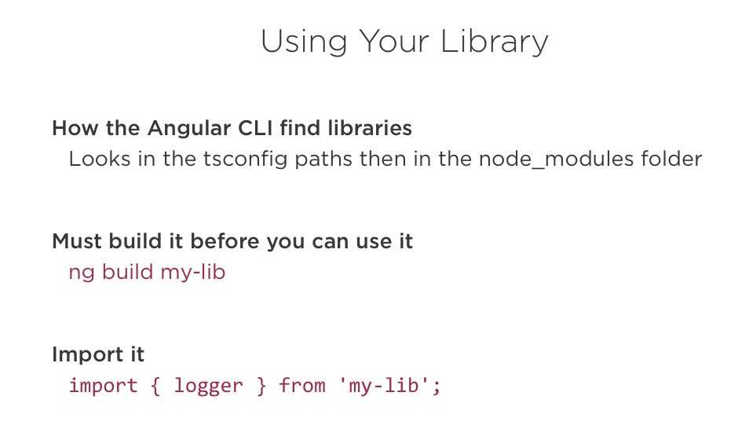

Slide 61
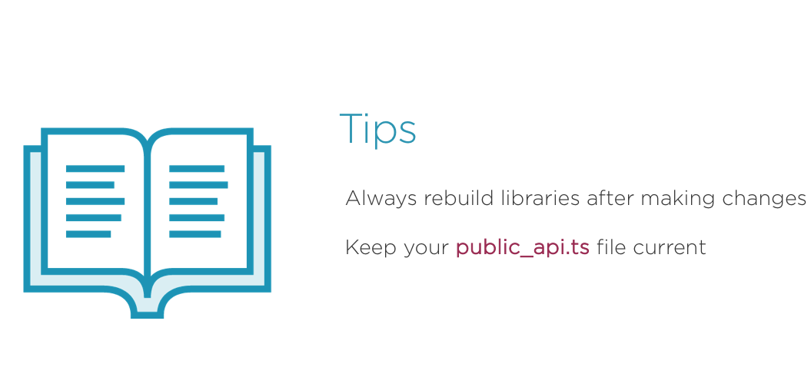

Slide 62
Publishing Your Library
Build your library for production
Publish to npm
How to publish to npm https://jpapa.me/npmpublish
ng build my-lib --prod
cd dist/my-lib
npm publish

Slide 63
LAB
Create a shared Angular library using the Angular CLI
Use the shared library in an Angular project
https://codewithdan.me/ng-architecture-labs
Lab: Building an Angular Library

Slide 64
How do you
... structure your components?
… communicate between components?
… assemble ViewModels from your data?
Notes:
Section 4 - Structuring components
Container/Presenter vs not
Component communication with RxJS
Assembling ViewModels from your data (map, switch,merge, etc)
Event bus

Slide 65
How do you
… communicate between components?
Notes:
Section 4 - Structuring components
Container/Presenter vs not
Component communication with RxJS
Assembling ViewModels from your data (map, switch,merge, etc)
Event bus

Slide 66
Container/Presenter Components
Popular pattern with roots in the Redux pattern.

Slide 67
Container / Presenter Components
Container
Presenter
Handle logic and getting/saving data
Present and tell the container when done

Slide 68
Container and Presentation Components
Container Component - Responsible for retrieving state
Presentation Component - Responsible for presenting/rendering state
Manage state (interact with service/store)
Container Component
Present state in UI
Presentation Component
Presentation Component

Slide 69
Container/Presentation Component Tips
Pass state from container → presentation using input properties
Communicate from presentation → container using output properties
Set change detection strategy to OnPush in presentation components
Presentation component's UI won't change and ngOnChanges() won't fire unless input property reference changes (or an event fires).
Consider cloning container component complex types or use Immutable.js.

Slide 70
Container / Presenter Components & Routing
Villains Container Component
Gets and saves villains over http, delegates how to present to each presenter via @Input()
Is handed the villain(s), let’s the user perform an action on the data, then hands it back to the container component
Villain List Presenter Component
Villain Detail Presenter Component
Villain Search Presenter Component

Slide 71
Container Class Example
villains-container.component.ts
export class VillainsComponent implements OnInit {
selected: Villain;
villains$: Observable<Villain[]>;
constructor(private villainService: VillainService) {
this.villains$ = villainService.entities$;
}
ngOnInit() { this.getVillains(); }
add(villain: Villain) { this.villainService.add(villain); }
askToDelete(villain: Villain) { … }
clear() { … }
deleteVillain() { … }
save(villain: Villain) { … }
select(villain: Villain) { this.selected = villain; }
update(villain: Villain) { … }
}

Slide 72
Container Template Example
villains-container.component.html
<div class="column is-8" *ngIf="villains$ | async as villains">
<app-villain-list *ngIf="!selected"
[villains]="villains"
[selectedVillain]="selected"
(selected)="select($event)"
(deleted)="askToDelete($event)"></app-villain-list>
<app-villain-detail *ngIf="selected"
[villain]="selected"
(unselect)="clear()"
(save)="save($event)"></app-villain-detail>
</div>

Slide 73
Walk-Through
Learn how container/presenter operates
Walk through a container/presenter app
https://github.com/johnpapa/heroes-angular
https://github.com/johnpapa/vikings
Container / Presenter

Slide 74
How do you
… send messages ?
Notes:
Section 4 - Structuring components
Container/Presenter vs not
Component communication with RxJS
Assembling ViewModels from your data (map, switch,merge, etc)
Event bus

Slide 75
Input and Output
Parent
Output
Output
Inputs
Child Component
Child Component

Slide 76
Communication Options
Event Bus - Loosely coupled option (mediator pattern)
Notify components of changes in a service (using the observer pattern) with Subject/BehaviorSubject/ReplaySubject
AppComponent
NavBar
Component
EventBusService
Feature Component
Child Component

Slide 77
Creating an Event Bus
An event bus provides a loosely coupled way to communicate. Follows the "mediator pattern".
@Injectable()
export class EventBusService {
private subject = new Subject<any>();
on(event: Events, action: any): Subscription {
return this.subject
.pipe(
filter((e: EmitEvent) => {
return e.name === event;
}),
map((event: EmitEvent) => {
return event.value;
})
)
.subscribe(action);
}
emit(event: EmitEvent) {
this.subject.next(event);
}
}
Notes:
Memoization - In computing, memoization or memoization is an optimization technique used primarily to speed up computer programs by storing the results of expensive function calls and returning the cached result when the same inputs occur again.
https://blog.mgechev.com/2017/11/12/faster-angular-applications-pure-pipes-memoization-pure-functions-part-2/

Slide 78
Raising an Event
Raise event by calling the event bus's emit() function
Pass an EmitEvent object with the event name and the event value
Inject EventBusService (mediator)
export class CustomersListComponent implements OnInit {
constructor(private eventbus: EventBusService) { }
selectCustomer(cust: ICustomer) {
this.eventbus.emit(new EmitEvent(Events.CustomerSelected, cust));
}
}
Pass event name
(as a string or enum)
and value
Notes:
Memoization - In computing, memoization or memoization is an optimization technique used primarily to speed up computer programs by storing the results of expensive function calls and returning the cached result when the same inputs occur again.
https://blog.mgechev.com/2017/11/12/faster-angular-applications-pure-pipes-memoization-pure-functions-part-2/

Slide 79
Subscribing to an Event
Subscribe to an event by calling the on() function and passing the event name to subscribe to and the callback function
Capture the returned subscription and unsubscribe in ngOnDestroy
export class AppComponent implements OnInit, OnDestroy {
eventbusSub: Subscription;
customer: ICustomer;
constructor(private eventbus: EventBusService) { }
ngOnInit() {
//Use event bus to provide loosely coupled communication (mediator pattern)
this.eventbusSub = this.eventbus.on(Events.CustomerSelected, (cust => this.customer = cust));
}
ngOnDestroy() {
this.eventbusSub.unsubscribe();
}
}
Listen for specific event
Notes:
Memoization - In computing, memoization or memoization is an optimization technique used primarily to speed up computer programs by storing the results of expensive function calls and returning the cached result when the same inputs occur again.
https://blog.mgechev.com/2017/11/12/faster-angular-applications-pure-pipes-memoization-pure-functions-part-2/

Slide 80
Event Bus Pros and Cons
Pros
Cons
Simple to use - call emit() or on()
Loosely coupled communication
Lightweight
Who is triggering the event?
Loosely coupled events can make maintenance more challenging (due to above)
Must remember to unsubscribe

Slide 81
Observable Services
Observable services can send data to observers/subscribers
Follows the "observer pattern"
Provides a simple way to keep multiple observers (components, services) up-to-date
Service can use RxJS Subject objects and observables
Subject
Component
subscribe
Observable Service
data

Slide 82
RxJS Subject Objects
RxJS provides several observable objects referred to as "subjects" that can be used to send data to observers
Subject – Send data to subscribed observers (any previously emitted data is not sent)
BehaviorSubject – Send last data value to observers as they subscribe
ReplaySubject - All previously sent data is also sent to new observers (this behavior can be changed)
AsyncSubject - Emits the last value (and only the last value) to observers when the sequence is completed
http://reactivex.io/documentation/subject.html
https://www.learnrxjs.io/
https://codewithdan.me/rxjs-decision
https://rxjs-dev.firebaseapp.com/api

Slide 83


Slide 84
Creating an Observable Service
An observable service uses a "subject" to expose an observable object
Create a Subject and Observable
@Injectable()
export class DataService {
customers: ICustomer[];
private customersSubject$ = new Subject<ICustomer[]>();
customersChanged$ = this.customersSubject$.asObservable();
addCustomer() : Observable<ICustomer[]> {
...
// Send customers data to any observers
this.customersSubject$.next(this.customers);
return of(this.customers);
}
}
Send data to any observers
Notes:
Memoization - In computing, memoization or memoization is an optimization technique used primarily to speed up computer programs by storing the results of expensive function calls and returning the cached result when the same inputs occur again.
https://blog.mgechev.com/2017/11/12/faster-angular-applications-pure-pipes-memoization-pure-functions-part-2/

Slide 85
Using BehaviorSubject
BehaviorSubject sends an initial value to observers as they subscribe
Initial data to send to new observer
@Injectable()
export class DataService {
customers: ICustomer[];
private customersSubject$ = new
BehaviorSubject<ICustomer[]>(this.customers);
customersChanged$ = this.customersSubject$.asObservable();
addCustomer() : Observable<ICustomer[]> {
...
// Send customers data to any observers
this.customersSubject$.next(this.customers);
return of(this.customers);
}
}
Send data to any observers
Notes:
Memoization - In computing, memoization or memoization is an optimization technique used primarily to speed up computer programs by storing the results of expensive function calls and returning the cached result when the same inputs occur again.
https://blog.mgechev.com/2017/11/12/faster-angular-applications-pure-pipes-memoization-pure-functions-part-2/

Slide 86
Subscribing to an Observable Service
Observers/consumers can access observable service data by subscribing
export class AppComponent implements OnInit {
customers: ICustomer[];
customersChangedSub: Subscription;
constructor(private dataService: DataService) { }
ngOnInit() {
//Example of using BehaviorSubject to be notified when a service changes
this.customersChangedSub = this.dataService.customersChanged$ .subscribe(custs => this.customers = custs);
}
ngOnDestroy() {
this.dataServiceSub.unsubscribe();
}
}
Subscribe to the observable
Notes:
Memoization - In computing, memoization or memoization is an optimization technique used primarily to speed up computer programs by storing the results of expensive function calls and returning the cached result when the same inputs occur again.
https://blog.mgechev.com/2017/11/12/faster-angular-applications-pure-pipes-memoization-pure-functions-part-2/

Slide 87
Observable Service Pros and Cons
Pros
Cons
Simple to use –subscribe/unsubscribe
Data source is known (simplifies maintenance)
Easy to share data between different layers of an application
Not as loosely coupled as an event bus (coupling between observable and observer)
Subject variations can be challenging to master
Must remember to unsubscribe

Slide 88
Using the AutoUnsubscribe Decorator
The AutoUnsubscribe decorator can automatically call unsubscribe for you
https://github.com/NetanelBasal/ngx-auto-unsubscribe
@AutoUnsubscribe()
export class AppComponent implements OnInit, OnDestroy {
eventbusSub: Subscription;
constructor(private eventbus: EventBusService, private dataService: DataService) { }
ngOnInit() {
//Use event bus to provide loosely coupled communication (mediator pattern)
this.eventbusSub = this.eventbus.on(
Events.CustomerSelected, (cust => this.customer = cust)
);
}
ngOnDestroy() {
// No need to manually unsubscribe from subscriptions here now
}
}
Must add ngOnDestroy()
Notes:
Memoization - In computing, memoization or memoization is an optimization technique used primarily to speed up computer programs by storing the results of expensive function calls and returning the cached result when the same inputs occur again.
https://blog.mgechev.com/2017/11/12/faster-angular-applications-pure-pipes-memoization-pure-functions-part-2/

Slide 89
Using SubSink
The SubSink package can simplify the cleanup of subscriptions
https://github.com/wardbell/subsink
export class AppComponent implements OnInit, OnDestroy {
subs = new SubSink();
constructor(private eventbus: EventBusService, private dataService: DataService) { }
ngOnInit() {
//Use event bus to provide loosely coupled communication (mediator pattern)
this.subs.sink = this.eventbus.on(
Events.CustomerSelected, (cust => this.customer = cust)
);
}
ngOnDestroy() {
this.subs.unsubscribe();
}
}
Unsubscribe from all subscriptions in SinkSub

Slide 90
BONUS LAB
Learn how an event bus can be used to communicate
Learn the role of different types of subjects in RxJS and how they can help with communication
https://labs.codewithdan.com/courses/2/labs/3
Component Communication

Slide 91
How do you
… keep consistent state across your app?
… update and access state?
Notes:
Section 4 - Structuring components
Container/Presenter vs not
Component communication with RxJS
Assembling ViewModels from your data (map, switch,merge, etc)
Event bus

Slide 92
State Management
Notes:
Section 4 - Structuring components
Container/Presenter vs not
Component communication with RxJS
Assembling ViewModels from your data (map, switch,merge, etc)
Event bus

Slide 93
State Management
Service
Ngrx
Ngxs
Mobx
Akita

Slide 94
Dependency Injection
Simplifies service acquisition
Simplifies testing (mock dependencies)
Inject services - don't "new" things up

Slide 95
ngrx
Client-side state management in Angular
Notes:
Services provide anything our app needs. And then we can share that across the entire application. They are the ultimate form of code reuse.

Slide 96
Shared state
Entity State
Heroes, Villains, Customers, Orders, Stock Quotes
Session State
User info, preferences, app settings, UX state, router config
Local State

Slide 97
Angular Service
Simplest approach (start here!)
Inject service where needed
Provide notifications using RxJS subjects
Component
Service
Component

Slide 98
Component
Component
Service
Service
Component
Component
Component
Service
Component
Component
Component
Service
Service
Component
Component

Slide 99
Problem
Proliferating services
Multiple copies of shared data
Inconsistent design and interaction patterns
Hard on teams

Slide 100
ngrx
Redux + RxJS = ngrx
Single source of truth for all application state
Immutable data
Provide consistency across a team
Consolidate multiple services into one
Diagnostic tool to watch store
Ngrx Store
https://github.com/ngrx/platform

Slide 101
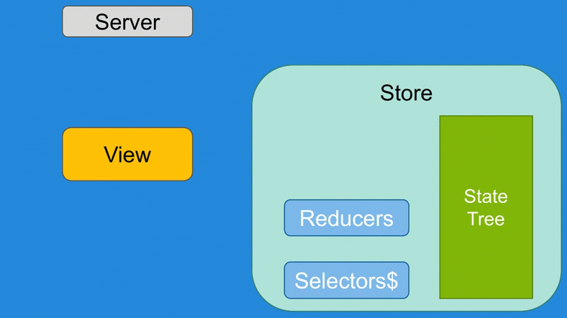
Ngrx Flow

Slide 102
Server
Effects
Store
Actions
State Tree
View
Actions
Actions
Reducers
Selectors$

Slide 103
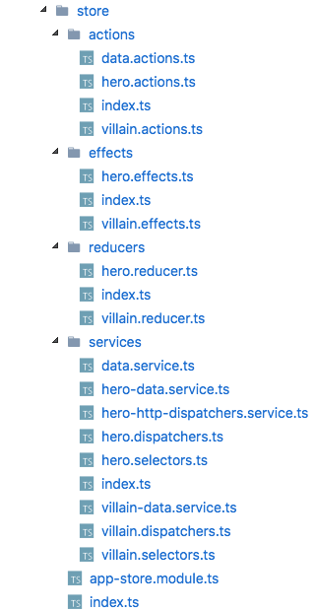
ngrx-demo
Store
Actions
Reducers
Dispatchers
Selectors
Effects
https://github.com/johnpapa/ngrx-demo

Slide 104
ngrx
Reactive redux client-side state management … with RxJS
Notes:
Services provide anything our app needs. And then we can share that across the entire application. They are the ultimate form of code reuse.

Slide 105
redux/ngrx principles
Single source of truth (cache)
Read-only shared state (immutability)
Pure functions update the state (synchronously)
Unidirectional data flow (like component inputs/outputs)

Slide 106
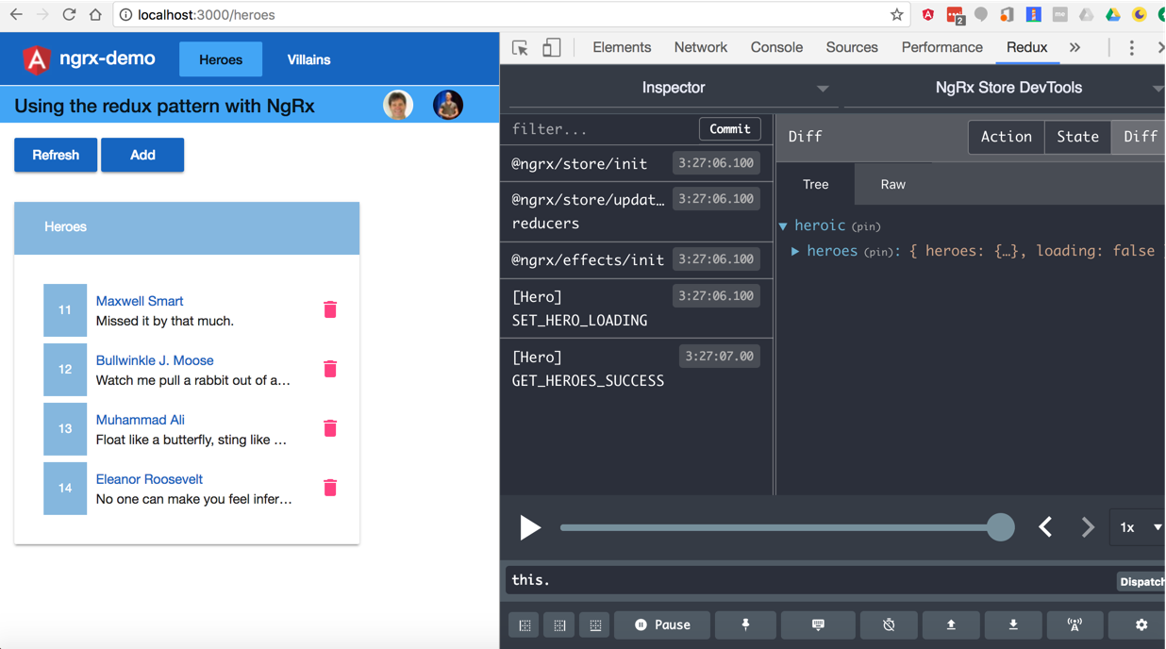

Slide 107
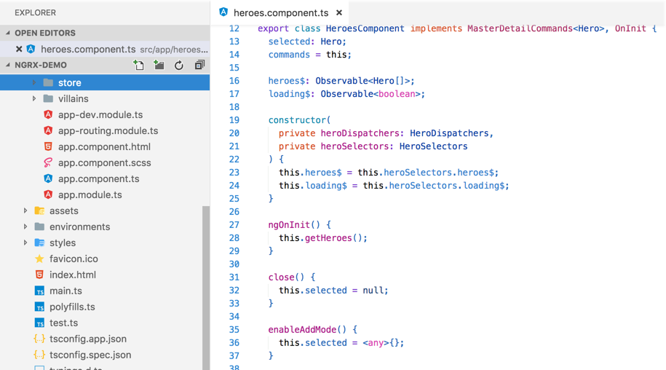
ngrx demo on the inside
Look in here

Slide 108
Let’s Think This Through
Too much boilerplate?
Entities are the bulk of the work
Code generation isn’t the answer (now you have more problems)
What if you wrote NOTHING !?
1 line of code per entity
It is ngrx (just greatly simplified)
ngrx-data
https://github.com/johnpapa/angular-ngrx-data

Slide 109
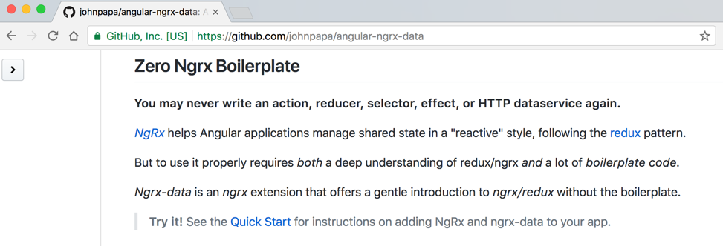
ngrx-data for entity state
https://github.com/johnpapa/angular-ngrx-data

Slide 110
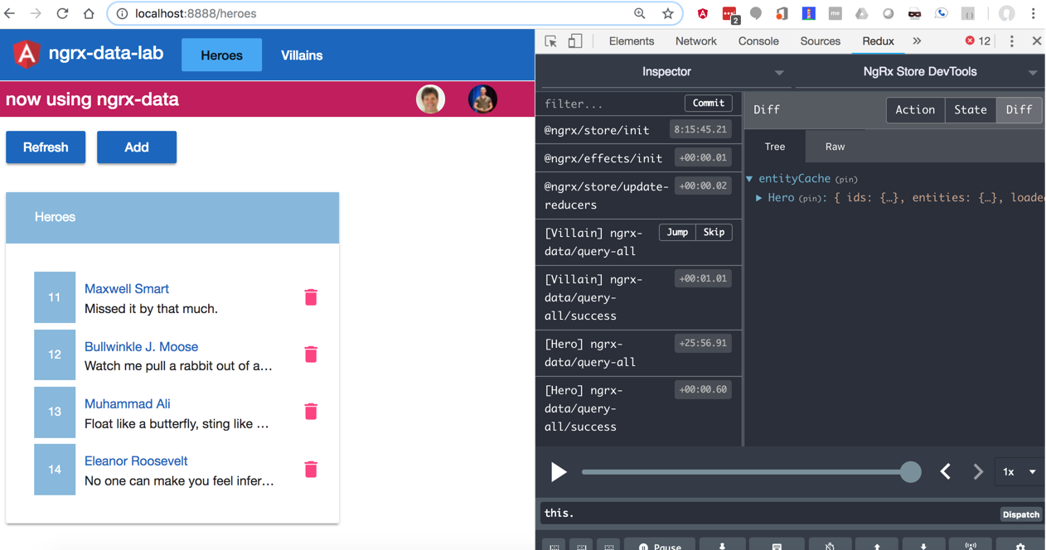

Slide 111
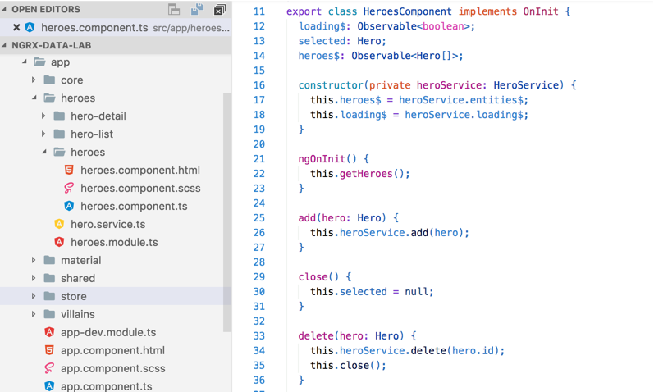
ngrx-data demo on the inside
Look in here

Slide 112
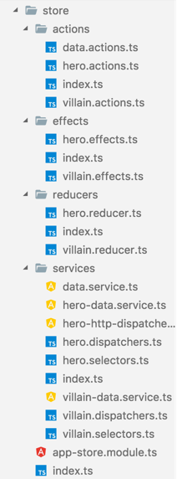
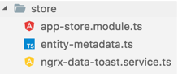
ngrx
ngrx-data

Slide 113
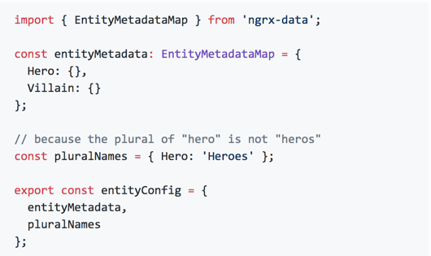
1. Define your EntityMetadata

Slide 114
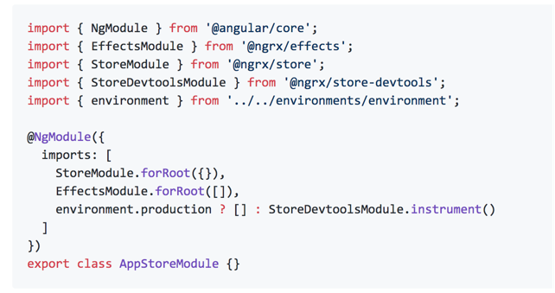
2. Add standard ngrx app module

Slide 115
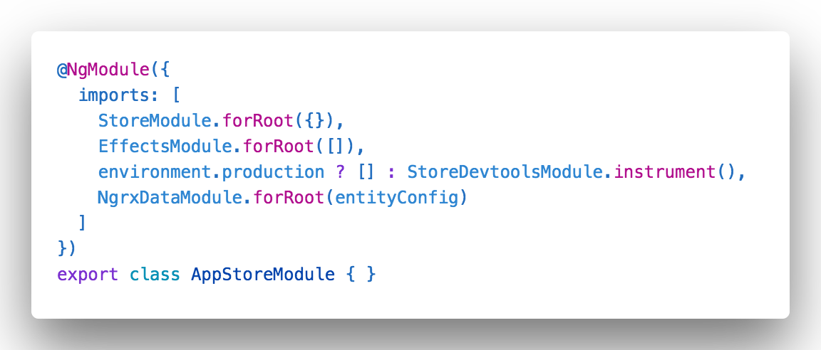
3. Add ngrx-data configuration to the store module

Slide 116
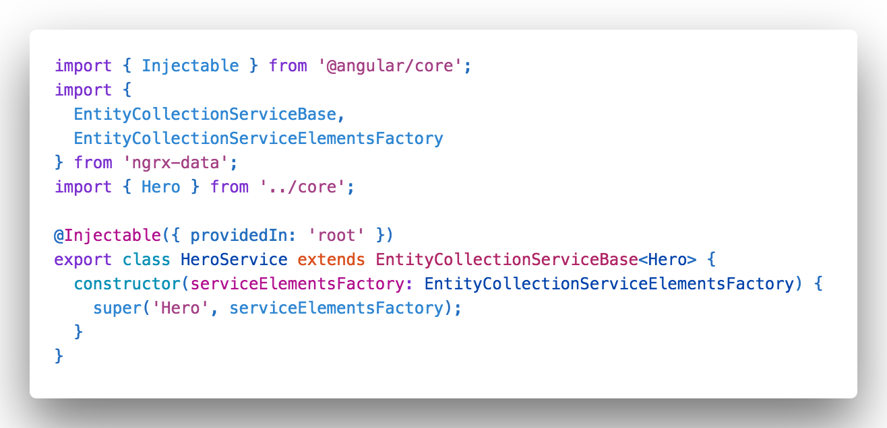
4. Write convenience façade service (optional)
Extend with convenience methods and observables over time

Slide 117
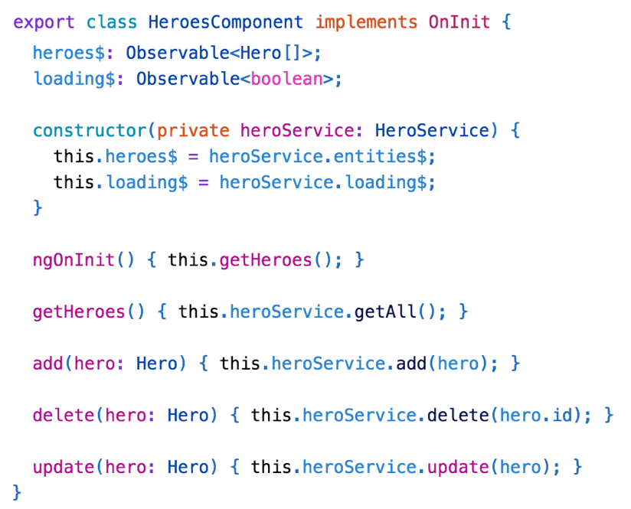
5. Use it in a component
Selectors$
Dispatchers
Notes:
Services provide anything our app needs. And then we can share that across the entire application. They are the ultimate form of code reuse.

Slide 118
You’re “done”!
Notes:
Services provide anything our app needs. And then we can share that across the entire application. They are the ultimate form of code reuse.

Slide 119
NgRx-Data Demo
Notes:
Section 4 - Structuring components
Container/Presenter vs not
Component communication with RxJS
Assembling ViewModels from your data (map, switch,merge, etc)
Event bus

Slide 120
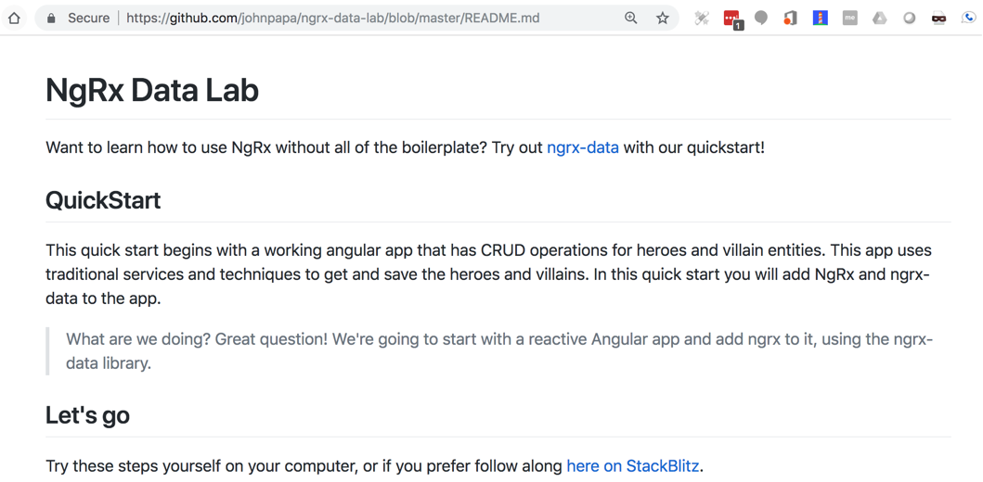
https://jpapa.me/ngrxdata-go
Lab: ngrx-data

Slide 121

You don’t need to know any of this - but in case you want deeper details ...

Slide 122

Under the hood
Notes:
Services provide anything our app needs. And then we can share that across the entire application. They are the ultimate form of code reuse.

Slide 123
It’s still ngrx … and plays nice with ngrx
Notes:
Services provide anything our app needs. And then we can share that across the entire application. They are the ultimate form of code reuse.

Slide 124

The Ngrx Cake
ngrx-data
Data for cached entity collections
@ngrx/entity
Entity collection and ”adapters”
@ngrx/effects
Effects HTTP, messages, side-effects
@ngrx/store
Store actions, reducers, selectors

Slide 125
ngrx-data is joining ngrx!
@ngrx/data
@ngrx/entity
@ngrx/effects
@ngrx/data
@ngrx/store
Notes:
Services provide anything our app needs. And then we can share that across the entire application. They are the ultimate form of code reuse.

Slide 126
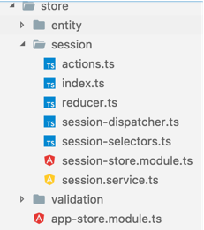
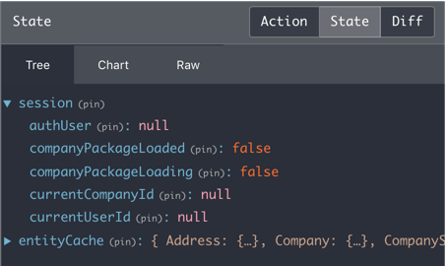
Session: a “feature” written in vanilla ngrx

Slide 127
When ngrx plain and when ngrx-data?
ngrx-data
ngrx
Forms-over-data app
Lots of entity types
Mostly create/read/update/delete
Beginners
Session data
Highly custom reducers
Complex state changes
High throughput

Slide 128
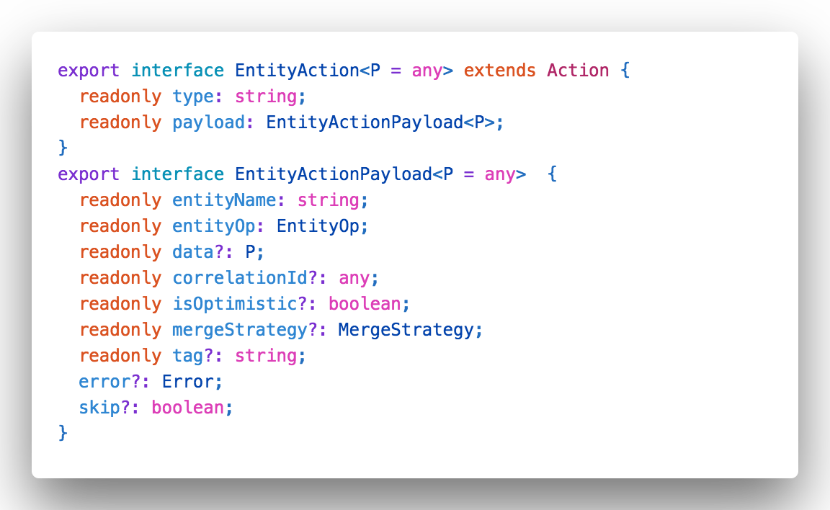
Entity Action

Slide 129
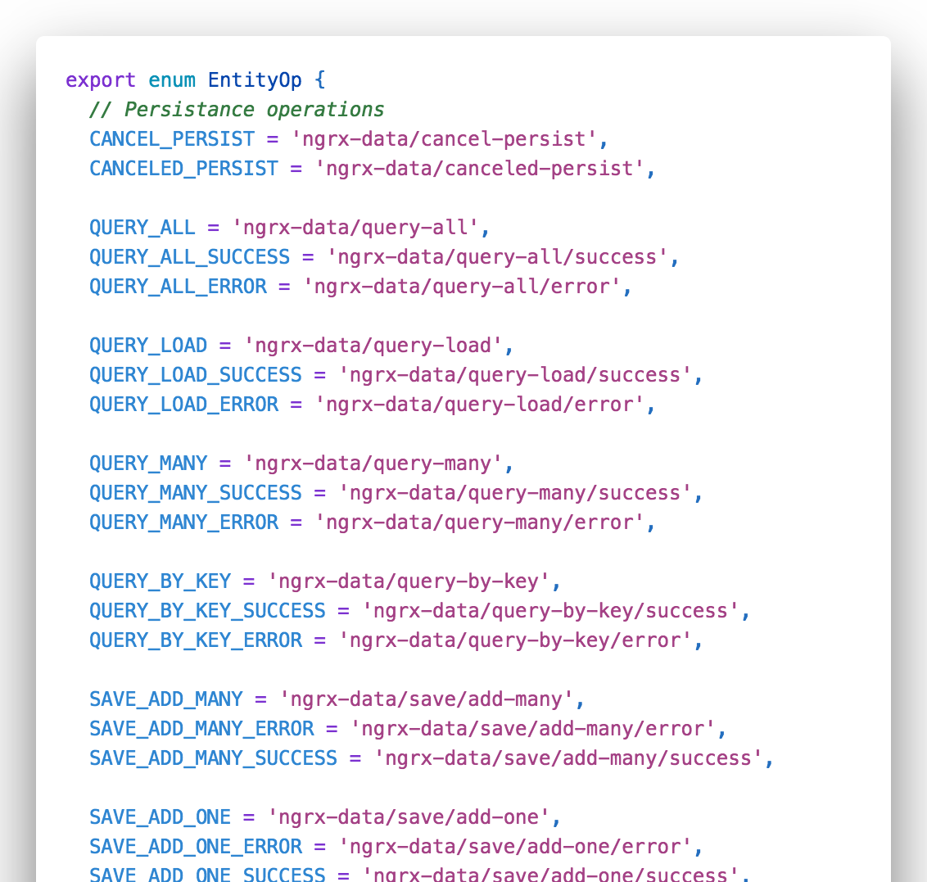
Entity Operations

Slide 130
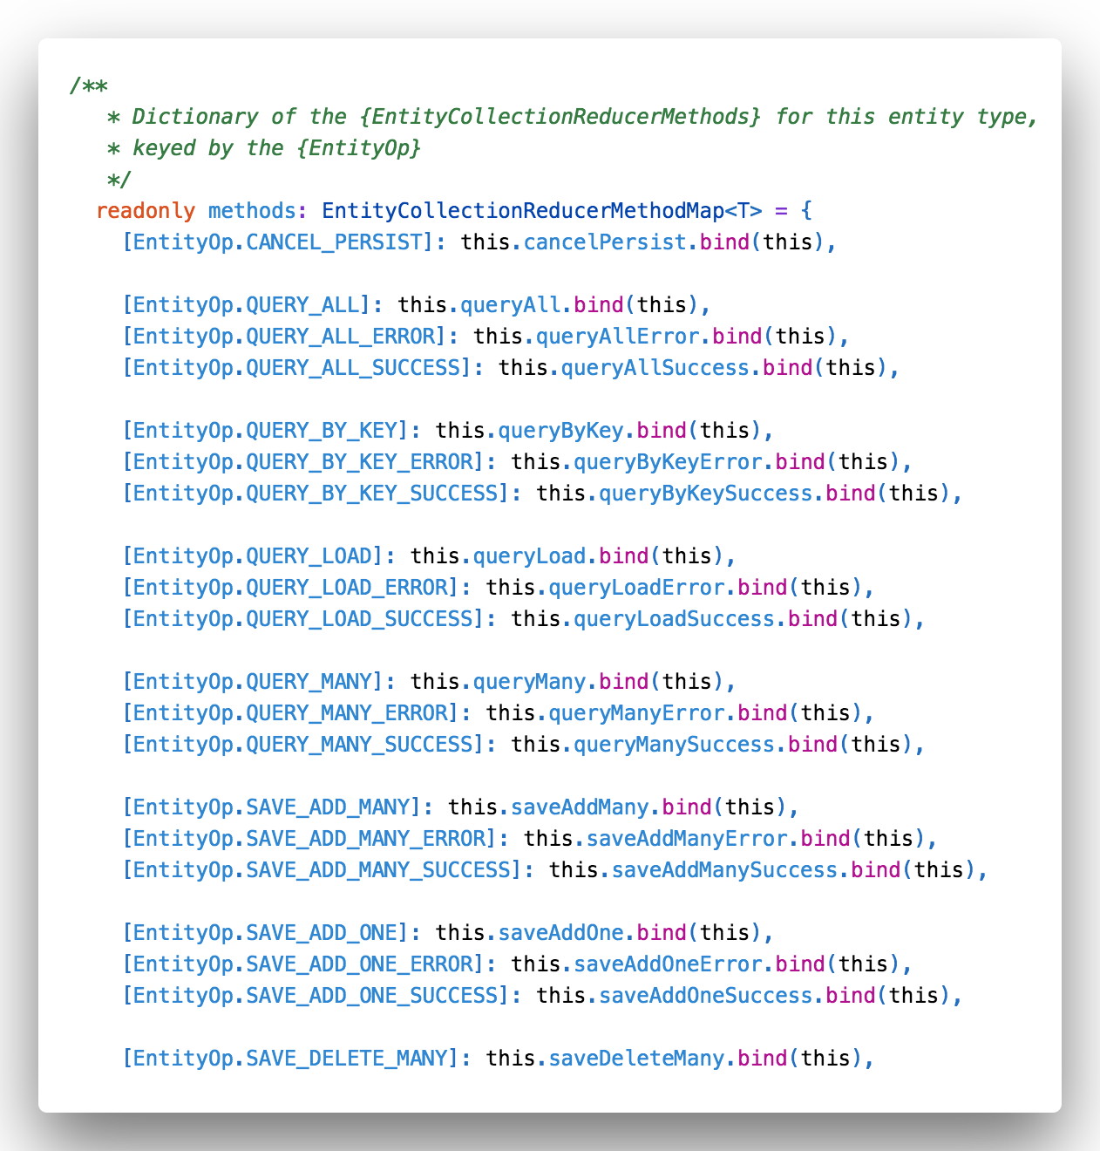
Entity Collection Reducers

Slide 131
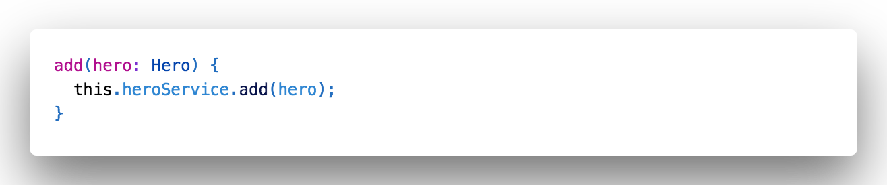
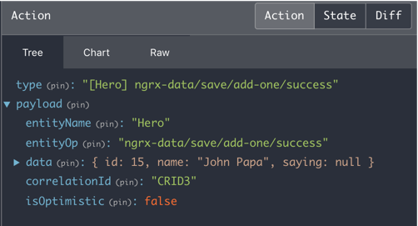
Entity action commands

Slide 132
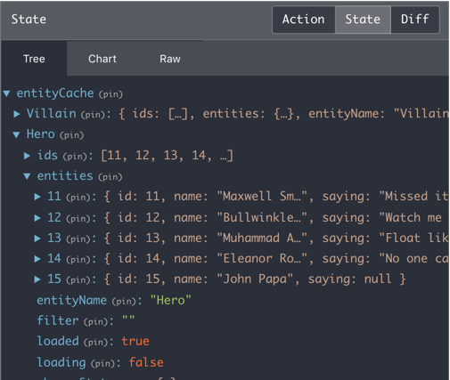
EntityCache holds collections for all entity types

Slide 133
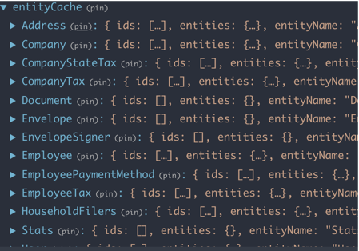
Actual example

Slide 134
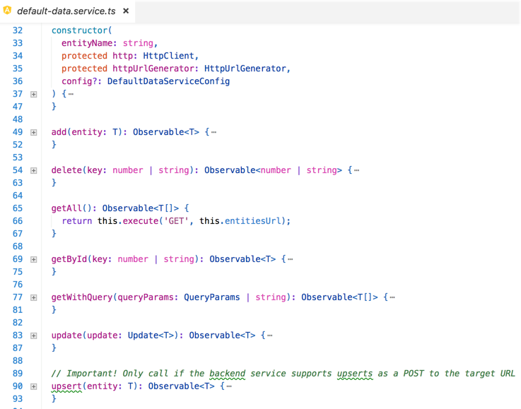
Default HTTP data service

Slide 135
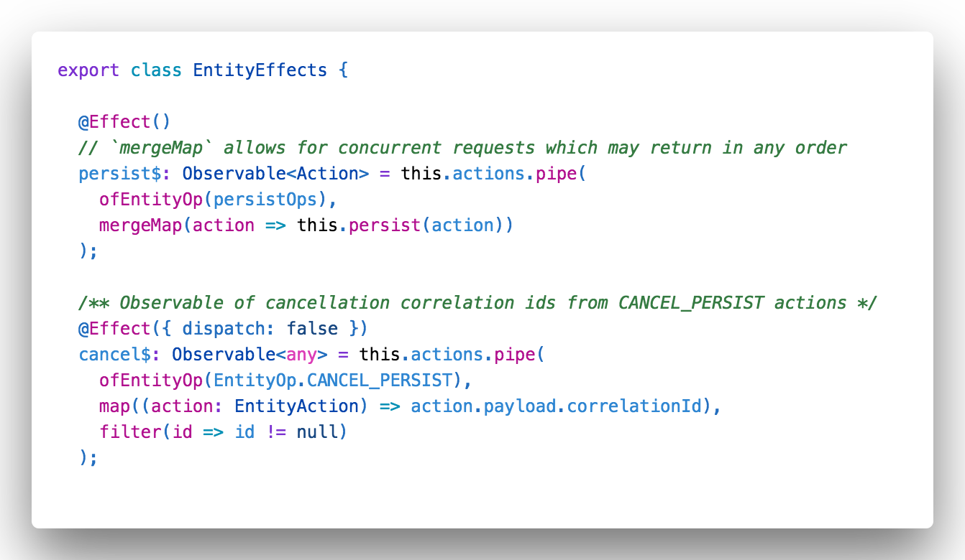
Ngrx-data Effects

Slide 136
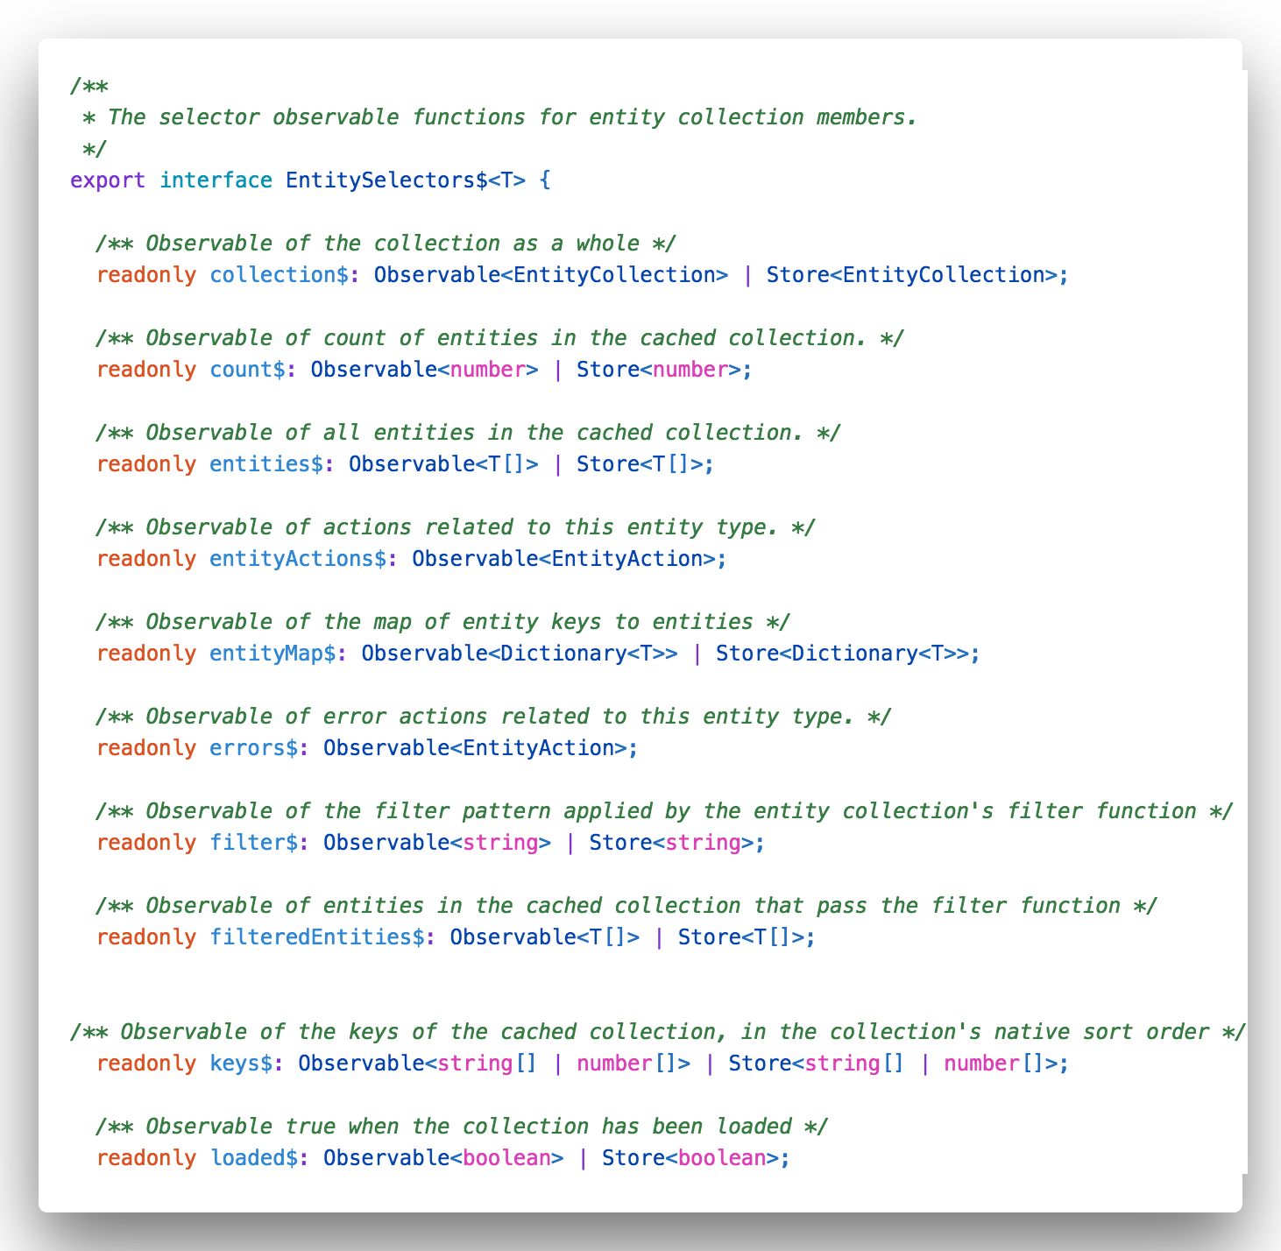
Selectors$ get data out

Slide 137
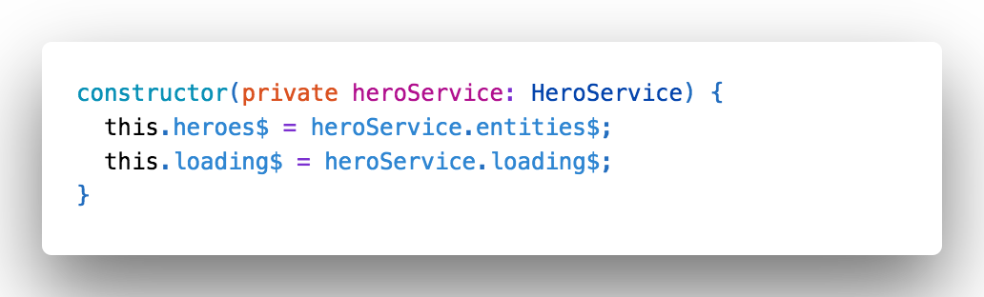
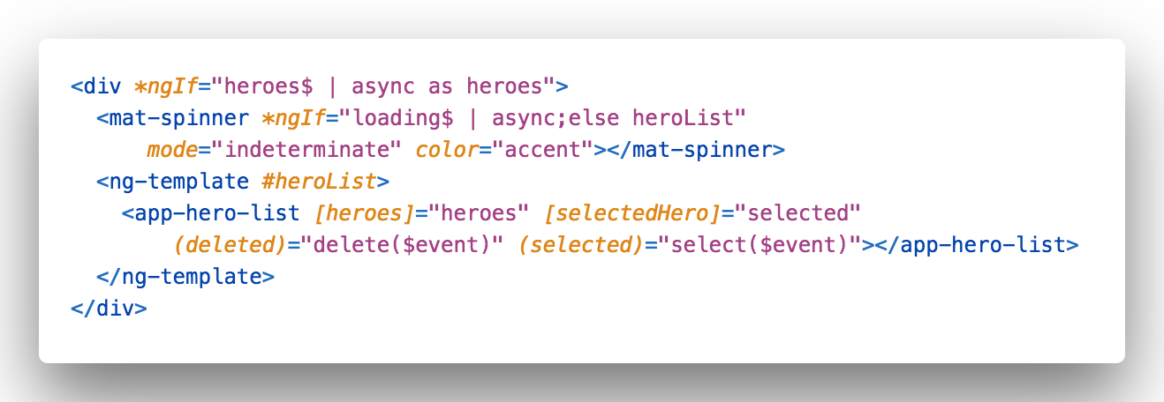
Bind directly to selector$ with AsyncPipe

Slide 138
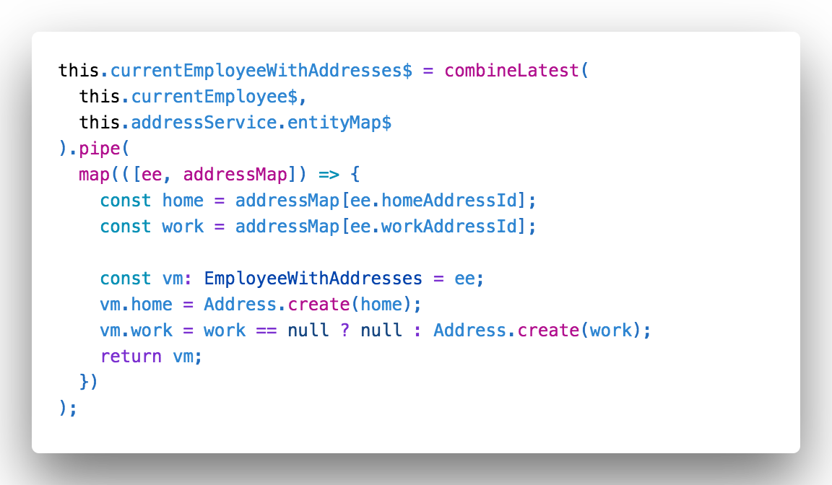
Entity relationships: combine selectors with RxJS

Slide 139
Entity Cache operations
Update many entities across the model before selectors$ fire
Notes:
Services provide anything our app needs. And then we can share that across the entire application. They are the ultimate form of code reuse.

Slide 140
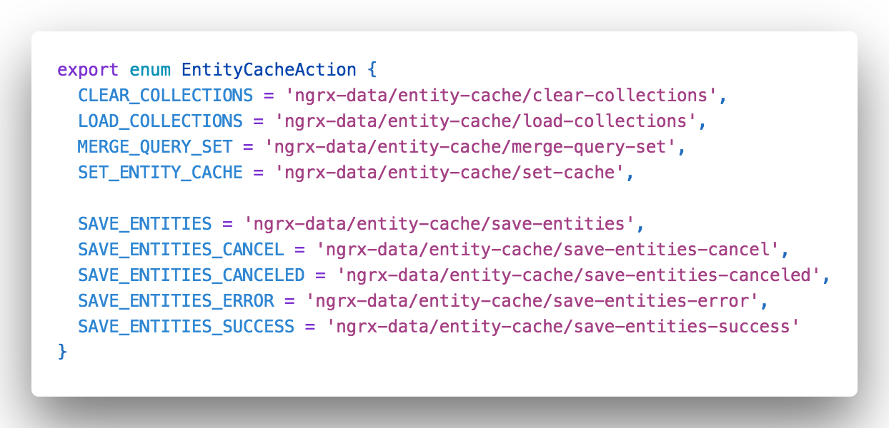
Actions over the entire entity cache

Slide 141
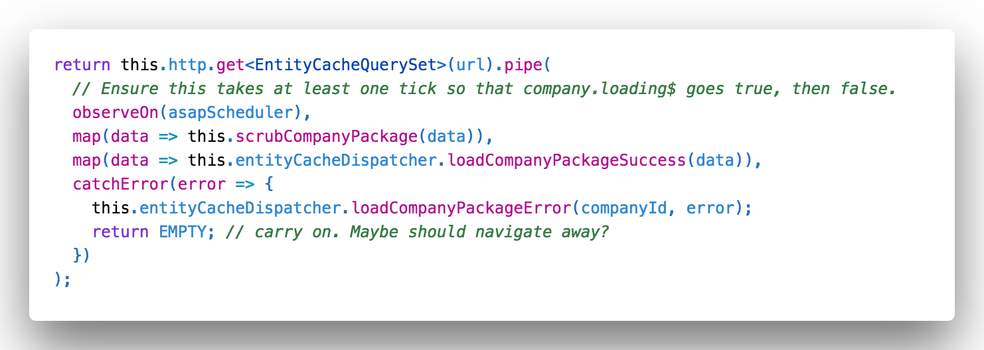
Loading multiple collections in one request

Slide 142
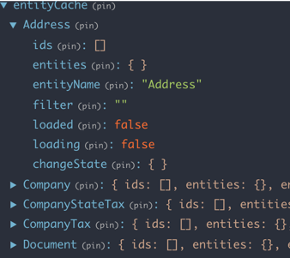
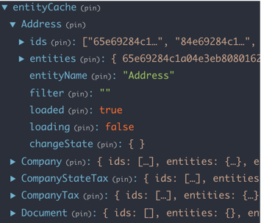
Before
After

Slide 143
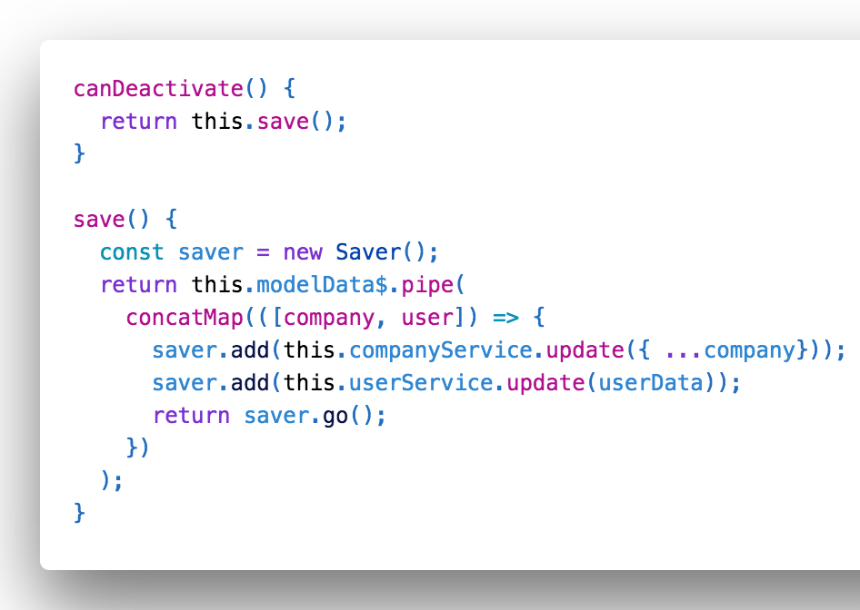
Save methods return observable
Wait for save before page closes
No guessing

Slide 144
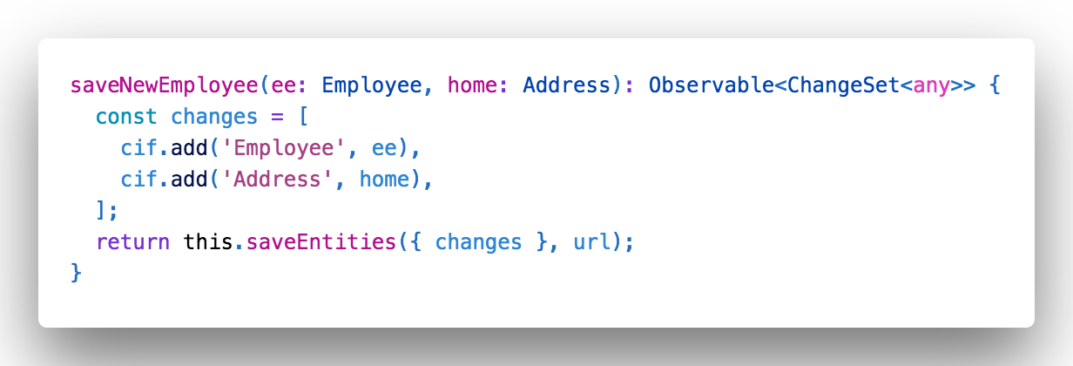
Save multiple entities in a transaction
Add, delete, and update many entities of different types in a single request
Your server-side API must understand the conventions

Slide 145
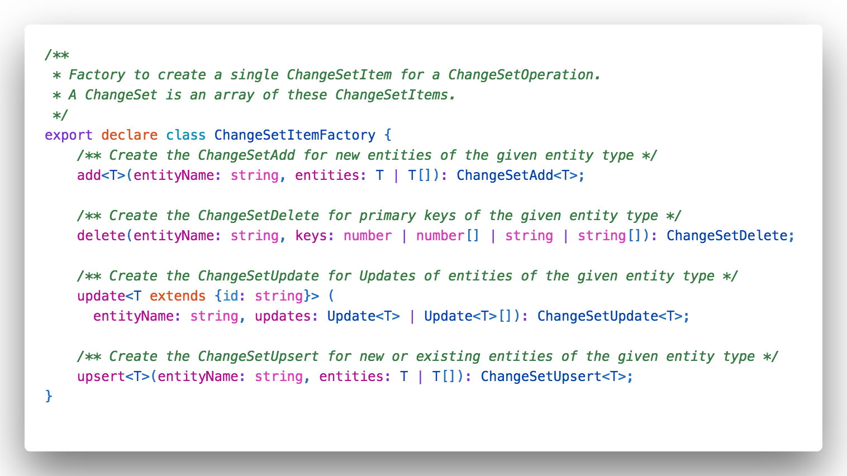
ChangeSets: {changes: [changeItem, changeItem, changeItem ...]}
Sequence of add/delete/update instructions

Slide 146
Extension points
Primary key not called id
Custom data access
Custom actions
Custom reducers
Custom default reducer methods
Custom effects

Slide 147
You don’t need to know any of this

Slide 148
ngrx-data Video
https://www.youtube.com/watch?v=t3jx0EC-Y3c&t=2088s
Notes:
Ward Bell

Slide 149
BONUS MATERIAL
Notes:
Section 4 - Structuring components
Container/Presenter vs not
Component communication with RxJS
Assembling ViewModels from your data (map, switch,merge, etc)
Event bus

Slide 150
How do you
… run your app anywhere?
… deploy your app to the cloud?
Notes:
Section 4 - Structuring components
Container/Presenter vs not
Component communication with RxJS
Assembling ViewModels from your data (map, switch,merge, etc)
Event bus

Slide 151
Run, Debug, Deploy with Docker
Notes:
Section 4 - Structuring components
Container/Presenter vs not
Component communication with RxJS
Assembling ViewModels from your data (map, switch,merge, etc)
Event bus

Slide 152

Debugging Node.js in Docker with VS Code
@john_papa

Slide 153
Dockerfile
@john_papa
3
2
1
Provides a recipe for creating and running our app
Configurable to adapt to different environments
Self contained script
Notes:
Samples are also included in download for this course, for Plus subscribers.

Slide 154
Dockerfile
1
Self contained script
@john_papa
3
2
Provides a recipe for creating and running our app
Configurable to adapt to different environments
Notes:
Samples are also included in download for this course, for Plus subscribers.

Slide 155
Dockerfile
1
Self contained script
2
Provides a recipe for creating and running our app
@john_papa
3
Configurable to adapt to different environments
Notes:
Samples are also included in download for this course, for Plus subscribers.

Slide 156
Dockerfile
1
Self contained script
2
Provides a recipe for creating and running our app
3
Configurable to adapt to different environments
@john_papa
Notes:
Samples are also included in download for this course, for Plus subscribers.

Slide 157
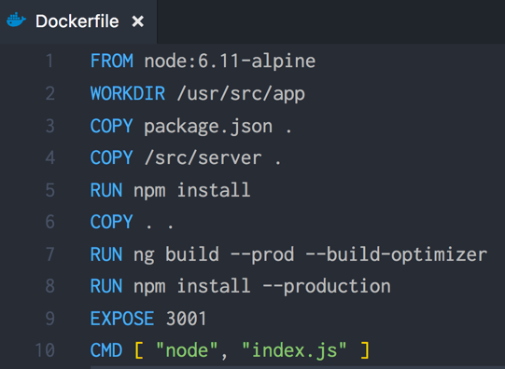

Sample Dockerfile
Now we can automate
@john_papa

Slide 158
Running Angular in Docker
Create Dockerfile
@john_papa

Slide 159
Running Angular in Docker
Create Dockerfile
Build and Run
@john_papa

Slide 160
Running Angular in Docker
Create Dockerfile
Build and Run
Debug
@john_papa

Slide 161
DEMO
Docker
@john_papa

Slide 162
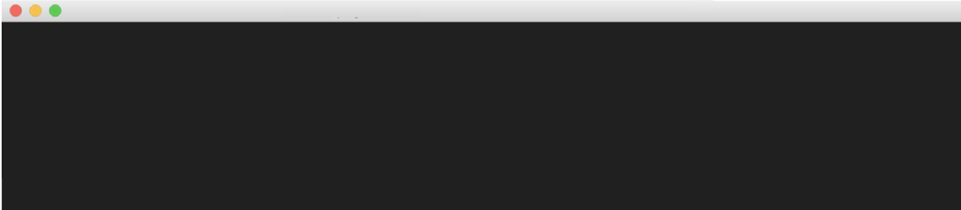
Containerize with Docker
Build the image
Tag it
Push it to Azure
docker-compose up –d
docker tag myimage myreg.azurecr.io/papa/myimage
docker push myreg.azurecr.io/papa/myimage
Push the Docker image to the Azure Container Registry
@john_papa

Slide 163
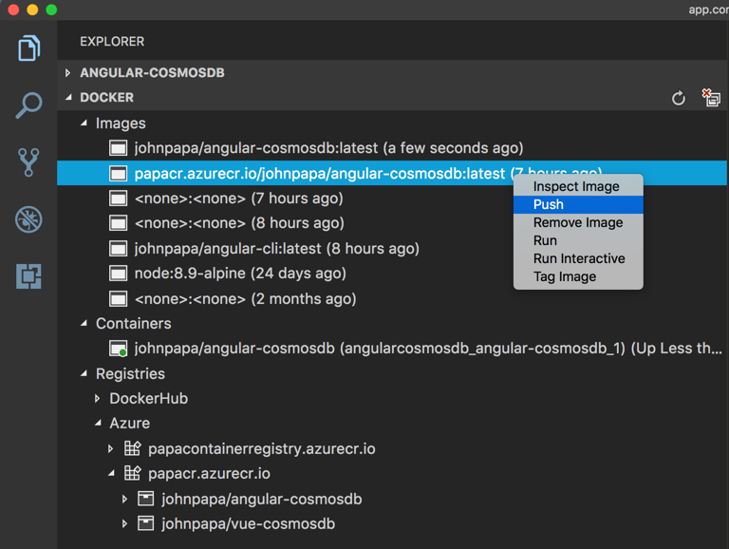
Docker from VS Code
@john_papa

Slide 164
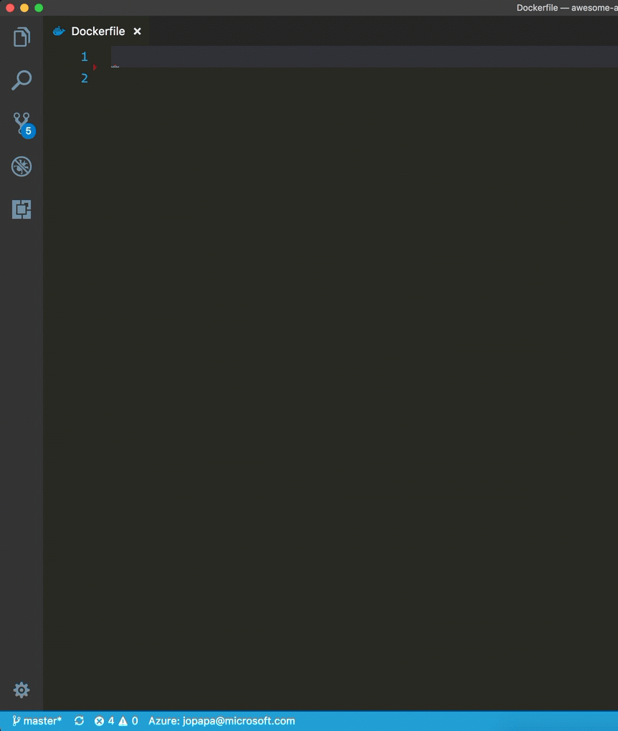
Code Snippets
Tips
https://aka.ms/ng-code
Tips
Use these snippets
docker-angular-multi-stage

Slide 165
Slides https://jpapa.me/awesomeng-slides
LAB
Requires: Docker and VS Code Docker extension
Define the docker files
Build and compose a local docker image
Run the container locally
Bonus
Inspect its logs
Explore its files
Debug the container
Lab: Deploy

Slide 166
Slides https://jpapa.me/awesomeng-slides
Install the Docker extension for VS Code https://aka.ms/docker-code
In VS Code, go to the Command Palette and Add Docker files to the workspace
When prompted, choose port 9070
In docker-compose.yml, add a new environment for PUBLICWEB: ./publicweb
Repeat the previous step, but in the docker-compose.debug.yml file
Remove all code from the Dockerfile
Use the docker snippet docker-angular-multi-stage to generate the contents
Modify the ng build command to be RUN ng build 7-deploy
Modify the final COPY command to be COPY --from=client-app /usr/src/app/dist/7-deploy ./
Run docker compose
Browse to http://localhost:9070
Lab: Deploy

Slide 167
OUR LABS
https://github.com/johnpapa/awesome-angular-workshop
Click the link above to get the demo we made in the workshop

Slide 168
Thanks for Coming!
@john_papa @wardbell
Slides https://jpapa.me/awesomeng-slides

Slide 169
APPENDIX

Slide 170
Routing Fundamentals

Slide 171
Angular Routing
Components can be swapped using @angular/router
Passing parameters between routes
Define parent and child routes
Eager / Lazy Loading
Routing Guards

Slide 172
Steps to Use Routing
Add a <base> Element
Define routes
Pass routes to the root module
Add a <router-outlet>
Use the routerLink Directive
1
2
3
4
5

Slide 173
Add a <base> Element
Router supports history.pushState
Allows paths like http://yourdomain.com/customers to be used
The <base> element needs to be set for it to work properly
index.html
<html> <head> <base href="/"> </head> <body> </body> </html>

Slide 174
Steps to Use Routing
Add a <base> Element
Define routes
Pass routes to the root module
Add a <router-outlet>
Use the routerLink Directive
1
2
3
4
5

Slide 175
Import Routes and RouterModule
RouterModule gives us access to routing features
Routes help us declare or route definitions
app-routing.module.ts
import { NgModule } from '@angular/core';
import { Routes, RouterModule } from '@angular/router';
Import routing features

Slide 176
Defining Routes
Define the route’s path
Indicate parameters with :
Set the component that we’ll route to
app-routing.module.ts
When I see this path, go to this component
const routes: Routes = [
{ path: '', pathMatch: 'full', redirectTo: 'customers' },
{ path: 'customers', component: CustomersComponent },
{ path: 'customers/:id', component: CustomerComponent },
{ path: '**', pathMatch: 'full', component: PageNotFoundComponent },
];

Slide 177
Define a Module
Create a routing module using our routes, and import it
Export our new AppRoutingModule
app-routing.module.ts
Only use forRoot() for the app root module’s routes
@NgModule({
imports: [RouterModule.forRoot(routes)],
exports: [RouterModule]
})
export class AppRoutingModule { }

Slide 178
Routing, All Together
app-routing.module.ts
import { NgModule } from '@angular/core';
import { Routes, RouterModule } from '@angular/router';
const routes: Routes = [
{ path: '', pathMatch: 'full', redirectTo: 'customers', },
{ path: 'customers', component: CustomersComponent },
{ path: 'customers/:id', component: CustomerDetailComponent },
{ path: '**', pathMatch: 'full', component: PageNotFoundComponent },
];
@NgModule({
imports: [RouterModule.forRoot(routes)],
exports: [RouterModule]
})
export class AppRoutingModule { }

Slide 179
Steps to Use Routing
Add a <base> Element
Define routes
Pass routes to the root module
Add a <router-outlet>
Use the routerLink Directive
1
2
3
4
5

Slide 180
Importing Routing in the AppModule
Pass application routes to the root module
Import our AppRoutingModule
app.module.ts
import { NgModule } from '@angular/core'; import { BrowserModule } from '@angular/platform-browser'; import { AppComponent } from './app.component'; import { CustomersComponent } from './customers/customers.component'; import { AppRoutingModule } from './app-routing.module';
import { DataService } from './core/services/data.service'; @NgModule({ imports: [ BrowserModule, AppRoutingModule ], declarations: [ AppComponent, CustomersComponent ], providers: [ DataService ], bootstrap: [ AppComponent ] }) export class AppModule { }
Import routes into our root module

Slide 181
Steps to Use Routing
Add a <base> Element
Define routes
Pass routes to the root module
Add a <router-outlet>
Use the routerLink Directive
1
2
3
4
5

Slide 182
RouterOutlet
@Component({ selector: 'app-container', template: `<router-outlet></router-outlet>` }) export class AppComponent { }
Define where components get loaded in the application
app.component.html
Angular puts components in a "component container"
<router-outlet> defines location where components are loaded

Slide 183
Steps to Use Routing
Add a <base> Element
Define routes
Pass routes to the root module
Add a <router-outlet>
Use the routerLink Directive
1
2
3
4
5

Slide 184
RouterLink Directive
The routerLink directive can be used to add links to routes
Defines the route path and any route parameter data
customer.component.ts
customer.component.html
@Component({
selector: 'customers',
templateUrl: './customers.component.html'
})
export class CustomersComponent {
// …
}
<a routerLink="/customers"> Customers </a>
<a [routerLink]="['/customers', customer.id]"> {{ customer.firstName }} </a>

Slide 185
NgModule Fundamentals

Slide 186
Roles of Angular Modules
Import other Angular Modules
Identify Components, Pipes, and Directives
Export its features
Provide services to injectors
Can be eagerly or lazily loaded
Notes:
We’ll learn more about providers, injectors, and lazy loading later in this course

Slide 187
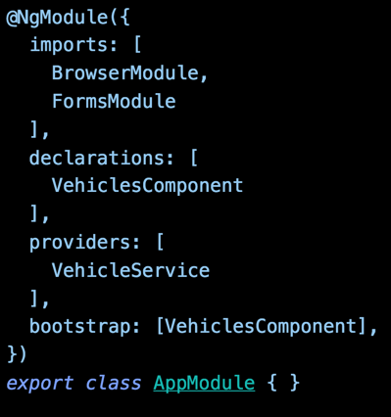
The Root Angular Module
Import modules we depend on
Declare components, directives, pipes
Provide services to app root injector
Bootstrap a component
Class to define the NgModule
Notes:
It identifies the module's own components, directives and pipes, making some of them public so external components can use them. It may add service providers to the application dependency injectors. And there are more options covered here.

Slide 188
The root NgModule is a manifest
Notes:
As an app grows it can have many NgModules. Our app is small now, let’s start with one. We’ll revisit Angular Modules when it’s time to expand

Slide 189
Services
A Service provides anything our application needs. It often shares data or functions between other Angular features
Notes:
Services provide anything our app needs. And then we can share that across the entire application. They are the ultimate form of code reuse.

Slide 190
Dependency Injection
Dependency Injection is how we provide an instance of a class to another Angular feature

Slide 191

Dependency Injection

Slide 192


Component
constructor(HeroService )
CustomersService
Injector
Service A
CustomersService
Service C
Service D
{ }
{ }
{ }
{ }
Notes:
Walk through the injector

Slide 193
Registering a Service Provider
Services must have a provider in order to be injected
app.module.ts
import { NgModule } from '@angular/core';
import { CustomersService } from '../core/services/customers.service';
@NgModule({ …
providers: [ CustomersService ] }) export class AppModule { }
Create a provider for service

Slide 194
Injecting a Service into a Component
Locates the service in the Angular injector
Injects into the constructor
customers.component.ts
export class CustomersComponent implements OnInit {
customers: ICustomer[];
constructor(private customersService: CustomersService) { }
ngOnInit() {
this.customers = this.customersService.getCustomers();
}
}
Inject service

Slide 195
Injecting a Service into a Service
Same concept as injecting into a Component
customers.service.ts
@Injectable()
export class CustomersService {
constructor(private http: HttpClient) { }
getCustomers() {
return this.http.get<ICustomer[]>(customersUrl);
}
}
Provides metadata about injectables
Injecting HttpClient

Slide 196
Providers Tip
ng g s data –m app.module
Generate a service and provide it in app.module.ts

Slide 197
Optimize and Deploy

Slide 198

Builds
Compile the app to an output directory
All builds use bundling
Prod builds add uglification and tree-shaking

Slide 199
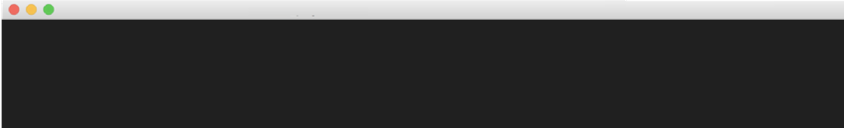
When it’s Time to Build
Developer Build
ng build
Output to /dist folder, by default (see angular.json)
ng build --prod
--build-optimizer
Production Build
(automatic in v5+)

Slide 200
Comparing Dev and Prod Build Targets
ng build
ng build --prod
Environment
environment.ts
environment.prod.ts
Cache-busting
only images referenced in css
all build files
Source maps
generated
not generated
Extracted CSS
global CSS output to .js
yes, to css file(s)
Uglification
no
yes
Bundling
yes
yes
AOT
no
yes
Tree Shaking
no
yes

Slide 201
Analyze and Optimize
ng build --prod --build-optimizer -sm
source-map-explorer dist/main.xxx.js
https://www.npmjs.com/package/source-map-explorer

Slide 202
Angular CLI Optimization Commands
Build for production (with AOT): ng build --prod
Build for production (AOT & optimized): ng build --prod --build-optimizer
Explore webpack bundles: source-map-explorer
webpack-bundle-analyzer

